Slide 1


4. Final Testing and
Reporting

Slide 2
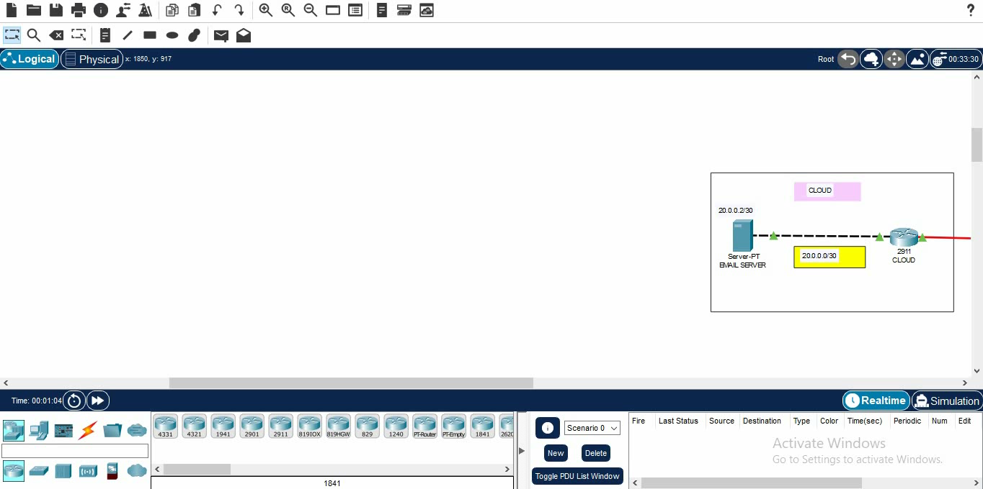
Ping E-mail Server

Slide 3
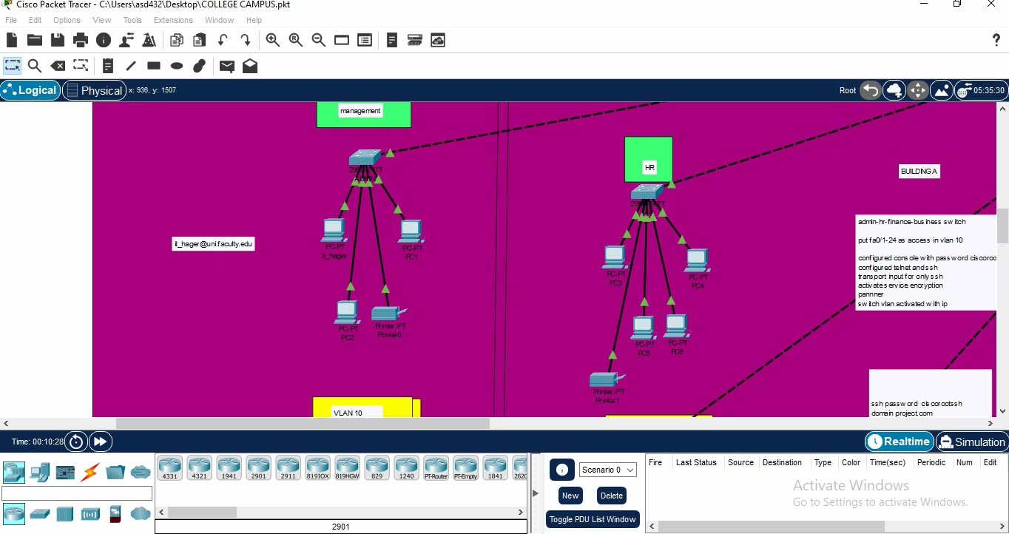
Send E-mail

